Slide 1

Università degli Studi di Firenze
Dipartimento di Elettronica e telecomunicazioni
Iacopo Magrini, iacopo.magrini@unifi.it
Appunti del corso “Lab in alta frequenza”
Tecniche di accesso ed architetture dei ricetrasmettitori per applicazioni wireless

Slide 2
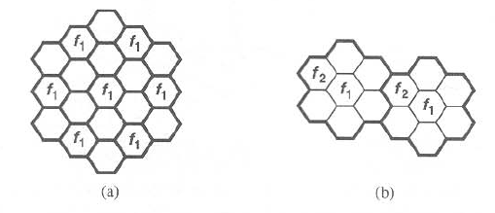
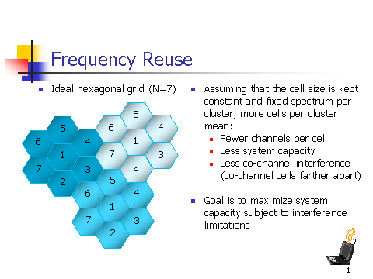
Frequency reuse
(a) Symple cellular system
(b) cellular system with “reuse”
Single GSM cell

Slide 3
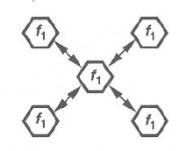
Co-Channel interference (CCI)
CCI=Distance between two cells with the same f
Cell radius
Dependent by the frequency reuse

Slide 4
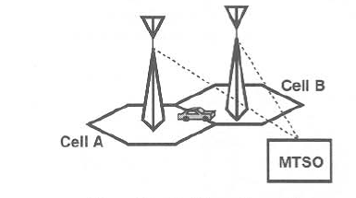
Handoff
“Handoff”= When S/N ratio drops below a thresold the MTSO
switch the link to another cell

Slide 5
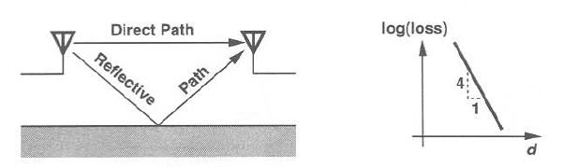
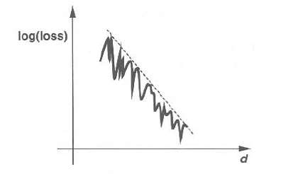
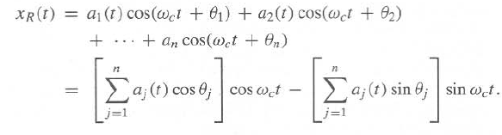
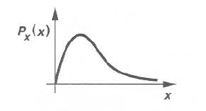

Multipath fading
Fading due to phase shift
Rayleigh distribution

Slide 6
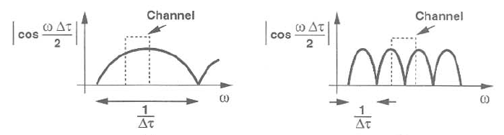
Delay Spread
Fading due to the delay signal

Slide 7
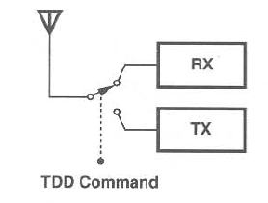
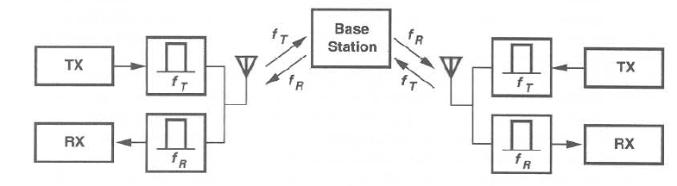
TDD & FDD
Time Division Duplexing
Frequency Division Duplexing

Slide 8
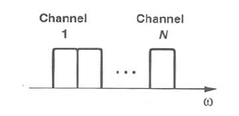
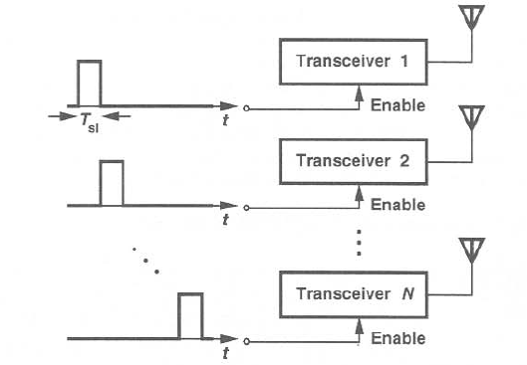
TDMA & FDMA
Frequency Division Multiple Access
Time Division Multiple Access

Slide 9
MODULATED RF SIGNAL
S(t)=Real[A(t)e
jωt
]
With A(t)=R(t)e
jθ(t)
jθ(t)
j(
ωt +
θ(t))
jωt
S(t)=Real[R(t)e e
] =Real[R(t)e
]
S(t)=Real[R(t)Cos(
ωt+ θ(t)) + jR(t)Sin(ωt+ θ(t))
]
=
R(t)Cos(
ωt+ θ(t))
R(t)
j
(ωt+ θ(t))
j
(ωt+ θ(t))
e
R(t)
-
And finally : S(t)=
+
e
2
2
R(t)/2
Amplitude
R(t)/2
Frequency
-ω
0
+ω

Slide 10

TRANSCEIVER FUNCTIONALITY
RF signal
Transceiver

Slide 11
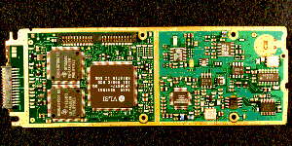
Transceivers trend
The trend for handset devices is to provide a global interconnectivity, the next
generation of such systems will include:
  GSM/EDGE WCDMA
  802.11 a/b/g standards
  GPS
  UWB
  DVB
  WiMax
  ……………………
UWB
2.5G/3G
FM
DVB
WiMax
WLan
GPS
GPS
MRadio?
2.5/3/3.9G
Obviously the multiradio functionality involves the antenna design as well

Slide 12
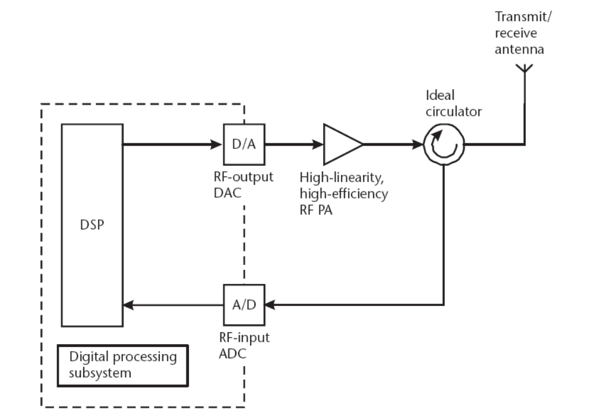
Ultimate solution
Cognitive radio concept based on SDR architecture, analog blocks
confined to PA only
Transmitter
Receiver
ADC/DAC compliant probably available within the next 15/20 years!

Slide 13
RX/TX Topologies
RX
Heterodyne receivers
Homodyne receivers (Zero-IF)
Quasi Homodyne receivers (Low-IF)
TX
Direct modulation
Indirect modulation
Polar

Slide 14
RECEIVER ARCHITECTURE(1)
Heterodyne reception
Desired
Band
Image
LPF
ω
ω
ω1
ωim
ωIF
ωIF
ωIF
ω
Cos(
ωLOt)
ωLO
Image Reject Filter
Image
Reject
Filter
LNA
ω
ω1
2ωIF
ωim
Cos(
ωLOt)

Slide 15
RECEIVER ARCHITECTURE(2)
Heterodyne reception
Image
Reject
Filter
Channel
Select
Filter
LNA
Image Reject Filter
Cos(
ωLOt)
Channel Select Filter
ωIF High
ω
ω
ω1
ωim
0
ωIF High
2ωIF
Image Reject Filter
Channel Select Filter
ωIF Low
ω
ω
0
ωIF Low
ω1
ωim
2ωIF

Slide 16
RECEIVER ARCHITECTURE(3)
Superheterodyne reception
LNA
Image reject
Channel Select
Channel Select
IF AMP
BPF1
BPF2
BPF3
A
B
C
D
E
F
G
ωLO1
ωLO2
BPF1
A
B
ω
ω
ωRF
ωLO1
ωI
ωRF
ωLO1
ωI
D
BPF2
C
ω
ω
ωIF1
BPF3
E
ω
F
ω
G
ω
ωIF2
ωIF2
ωIF2

Slide 17
FREQUENCY CONVERSION (1)
G(ω)=-jSign(ω)
Hilbert
Transform
Reject Image Mixer
90°
Sin
ωot
Σ
Cos
ωot
F image
F image
-ωo
0
ωo
-ωo-IF
-ωo+IF
ωo-IF
ωo+IF
-IF
0
IF

Slide 18
FREQUENCY CONVERSION (2)
X
Cos(
ωot)
1
1
1
1
(-ωo-IF)
(-ωo+IF)
0
(ωo-IF)
(ωo+IF)
-ωo
ωo
X
1/2
1/2
[δ(ω+ ω0)+ δ(ω- ω0)]
2
-ωo
0
ωo
1/2
1/2
1/2
1/2
1/2
1/2
1/2
1/2
+
-2ωo
-ωo
0
0
ωo
2ωo
1/2
1/2
1/2
1/2
1/2
1/2
-2ωo
-ωo
0
ωo
2ωo

Slide 19
FREQUENCY CONVERSION (3)
X
Sin(
ωot)
(-ωo-IF)
(-ωo+IF)
0
(ωo-IF)
(ωo+IF)
-ωo
ωo
X
j/2
ωo
j[δ(ω+ ω0)- δ(ω- ω0)]
-ωo
0
2
-j/2
j/2
j/2
j/2
j/2
1/2
1/2
+
2ωo
-2ωo
-ωo
0
0
ωo
-j/2
-j/2
-j/2
-j/2
j/2
j/2
j/2
j/2
2ωo
-2ωo
-ωo
0
ωo
-j/2
-j/2
-j/2
-j/2

Slide 20
FREQUENCY CONVERSION (4)
X
G(
ω)
j/2
j/2
j/2
j/2
2ωo
-2ωo
-ωo
0
ωo
X
-j/2
-j/2
-j/2
-j/2
+j
G(ω)
ω
-j
1/2
1/2
-2ωo
2ωo
-ωo
0
ωo
-1/2
-1/2
-1/2
-1/2
-1/2
-1/2

Slide 21
FREQUENCY CONVERSION (5)
Σ
1/2
1/2
1/2
1/2
1/2
1/2
-2ωo
-ωo
0
ωo
2ωo
+
1/2
1/2
-2ωo
2ωo
-ωo
0
ωo
-1/2
-1/2
-1/2
-1/2
-1/2
-1/2
-ωIF
ωIF

Slide 22
ZERO IF RECEIVERS(1)
The IF is then zero & the mirror
signal is equal to the wanted signal
A sine brings both the wanted
signal from the positive & negative
frequencies to the base band.
These signals are each other mirror
image & are superimposed
This problem is solved by doing the
down conversion twice.
RF Filter
LNA
Base Band
Cosωct
Wanted
signal
Modulated
RF Signal
-ωc
ωc
Cos ωct
-ωc
ωc
Base Band

Slide 23
ZERO IF RECEIVERS(2)
A(t)
A(t)
x Cos(ωct) +
j A(t)xSin(ωct)
jωct
e
= Cos(ωct)+ jSin(ωct)
Re
Im
1/2
1/2
Cos(ωct)
-ωc
ωc
Re
Im
J/2
Sin(ωct)
+
-ωc
ωc
-J/2
xj
Re
Im
1/2
jSin(ωct)
-ωc
ωc
-1/2
Re
1
Cos(ωct)+ jSin(ωct)
ωc

Slide 24
ZERO IF RECEIVERS(3)
A(t)
A(t)
x Cos(ωct) +
j A(t)xSin(ωct)
jωct
e
= Cos(ωct)+ jSin(ωct)
A(t)xSin(ωct)
Sin(ωct)
A(t)
90°
Cos(ωct)
0°
Cos(ωct)
A(t) x Cos(ωct)

Slide 25
ZERO IF RECEIVERS(4)
Q
RF Filter
Sin(ωct)
The advantage of the zero IF receiver
is :no need for high Q tunable band pass
filters.
A drawback of the zero IF is the DC
offset which is created during the down
conversion (result of the crosstalk
between the RF & LO inputs of the mixers.
LNA
90°
LO
0°
Cos(ωct)
Wanted
signal
I
Modulated
RF Signal
-ωc
ωc
jωct
ωc
e
Base Band

Slide 26
Zero_IF pro & cont
Zero-IF
Wanted
signal
Modulated
RF Signal
Low pass Filter
Q
RF Filter
Sin(ωct)
-ωc
ωc
LNA
90
LO
jωct
0
e
Cos(ωct)
ωc
I
Low pass Filter
Base Band
Simple structure
No image frequency
Low pass filtering
No 50 Ohm load to drive
Dc-offset
IM2 sensibility
Flicker Noise sensibility
Low isolation between RF ed LO ports
Notes:
Talk about the needed of high IIP2 and IIP3 for application multichannel TDD and focus on mixer contribution.
Ricordarsi che i prodotti im2 fuoriescono per la presenza di DC…vedi studio philips

Slide 27
NEAR ZERO IF RECEIVERS
Q
RF Filter
Sin(ωct)
The near zero IF is totally insensitive
to any DC-signal whatever its origin .
The low IF filters will be LF filters that
allow analog integration easy .
The main problem of the near zero IF
is the reqired mirror suppression that
can be performed only by polyphase
filters .
LNA
90°
LO
0°
Cos(ωct)
I
Mirror
signal
Wanted
signal
Modulated
RF Signal
-ωc
ωc
ωc
jωct
Low IF
Low IF
To be filtered with polyphase filters
Base Band

Slide 28
POLYPHASE FILTERS(1)
A Polyphase filter is a normal filter plus an image rejection.
A Polyphase filter is similar in function and implementation to a real filter
exept for the fact that it is able to diffentiate between positive & negative
frequencies.
A real filter has a transfer function that is symetric about DC (i.e it has two
identical pass bands corresponding to positive & negative frequencies).
A polyphase filter can have its passband either positive or negative ,or both .

Slide 29
POLYPHASE FILTERS(2)
Polyphase filter with negative frequency rejection
Positive frequency input
Q_in = I_in*exp+j(π /2)
I_out = I_in + Q_in*exp-j(π /2)
= I_in + I_in
= 2*I_in
Q_out = Q_in + I_in*exp+j(π /2)
= Q_in + Q_in
= 2*Q_in
Negative frequency input
Q_in = I_in*exp-j(π /2)
I_out = I_in + Q_in*exp-j(π /2)
= I_in - I_in
= 0
Q_out = Q_in + I_in*exp+j(π /2)
= Q_in - Q_in
= 0
adder I
I_in
2*I_in
I_in
Σ
Filter I
I_out
I_in
Q_in*exp-j(π/2)
Shift 90°
Shift -90°
Q_in
I_in *exp+j(π /2)
Σ
2*Q_in
Q_in
Filter Q
Q_out
adder Q
Q_in

Slide 30
POLYPHASE FILTERS(3)
Real Filter
The impulse response
(time domain) is a real
The response for positive
freqencies is the same than
for negative frequencies
Xr(t)
Hr(jω)
Yr(t)
Hr(t)=Real
Hr(jω)=Hr*(- jω)
|Hr(jω)|=|Hr (- jω)|
arg(Hr(jω))=-arg(Hr(-jω))
Polyphase Filter
(two phases)
The impulse response
(time domain) is a complex
The response for positive
or negative frequencies is
different
Xr(t)
Yr(t)
Hp(jω)
Hp(t)=Hr(t)+jHi(t)
Xi(t)
Yi(t)
Hp(jω)=Hr(jω)+jHi(j ω)
|Hp(jω)|≠|Hp(- jω)|
arg(Hp(jω)) ≠ -arg(Hp(-jω))

Slide 31
POLYPHASE FILTERS(4)
The most important application for a polyphase filter is the suppression of positive or
negative frequency component of a complex signal .
This can be done with a band pass filter resulting of the linear tranformation of a low
pass filter .The classic lowpass to bandpass transformation does not change the real
properties of the lowpass filter .
In that case the band pass filter has the lowpass filter characteristic around +/-ωc .
j ω
j ωc
ω
ωc
ωc
ω
1
1
-ωc
-ωo
+ωo
+ωc
ω
1+j
ω
ω²
-
ωc²
ωo
1+j (
ωo
ωc
)
Shift
Shift
LP
BP
With a polyphase filter the linear transformation in use (lowpass to band pass) makes the
bandpass characteristic similar to the lowpass only around + ωc .
j ω
j ω- j ωc
1
1
ω
ω
ωc
-ωo
+ωo
+ωc
ω
1+j
1+j (
-
)
ωo
ωo
LP
BP
Shift

Slide 32
Receivers Structures (III)
Low-IF
Wanted
signal
Modulated
RF Signal
Q
RF Filter
Sin(ωct)
Polyphase
Filter
-ωc
ωc
jωct
LNA
90
LO
e
0
ωc
Cos(ωct)
To be filtered with polyphase filters
I
Base Band
Low IF
Low IF
Simple structure
Low pass filtering
No 50 Ohm load to drive
IM2 sensibility
Low isolation between RF ed LO ports
Structure balancing
Notes:
Talk about the needed of high IIP2 and IIP3 for application multichannel TDD and focus on mixer contribution

Slide 33
TRANSMITTER ARCHITECTURE(1)
Indirect Modulation Transmitter
I
Cosω1t
LPF
IRF
B(t)
DSP
Σ
PA
Sinω1t
90°
Cosω2t
Q
Hilbert
Transform
1
2
3

Slide 34
TRANSMITTER ARCHITECTURE(2)
Indirect Modulation Transmitter
ω
-ω2
-2ω1
-ω1
0
ω1
2ω1
ω2
1
IM
IM
ω
-(ω1+ ω2)
-(ω2- ω1)
0
(ω2- ω1)
(ω1+ ω2)
2
ω
-(ω1+ ω2)
0
(ω1+ ω2)
3

Slide 35
TRANSMITTER ARCHITECTURE(3)
Direct Modulation Transmitter
I
Cosω1t
B(t)
DSP
Σ
PA
Sinω1t
90°
Q
Hilbert
Transform

Slide 36
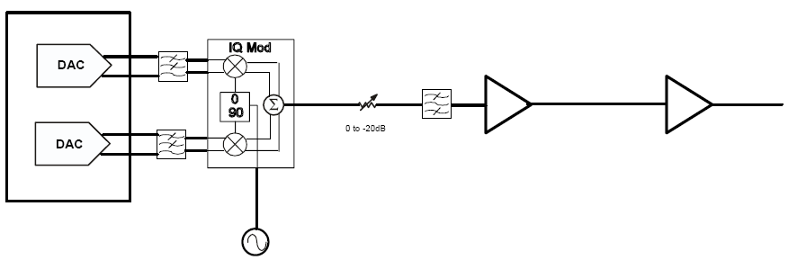
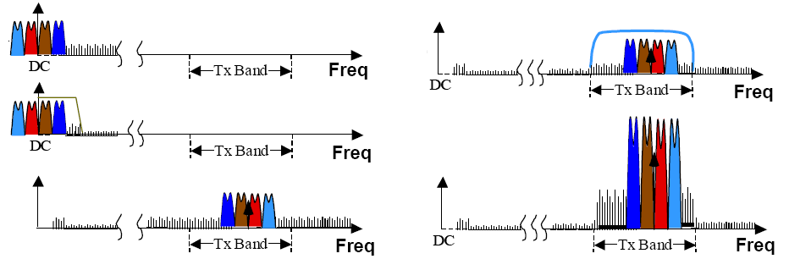
Zero-IF/Direct conversion
Tx-Band Filter
1 2
Driver
PA
3
4
5
Simple structure
The MultiRadio specs are related to the DAC and PA capabilities
No IF filters
LO residual affects the EVM (good LO suppression is needed)
PA to LO leakage can modulate or pull the VCO
1
4
2
LO leakage
3
5

Slide 37
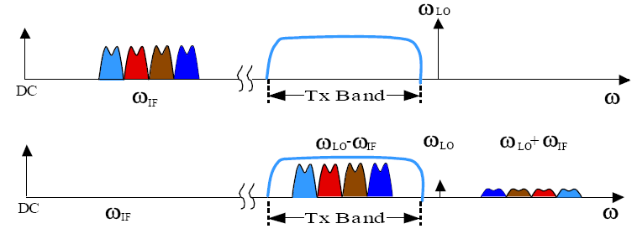
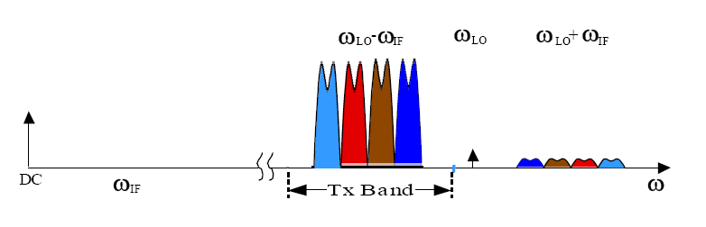
Low-IF conversion
Tx-Band Filter
1
Driver
PA
2
3
Simple structure
The MultiRadio specs are related to the DAC and PA capabilities
The DAC provides a complex signal
Lo signals can be theoretically filtered out
To cut LO residual the IF has to be quite high (tough DAC specs)
Selective RF filters
1
3
2

Slide 38
TRANSMITTER ARCHITECTURE(3)
Direct Modulation Transmitter With Offset VCO
Mixer
I
Mixer
BPF
90°
Σ
PA
Cosω1t
Q
Cosω2t
Mixer

Slide 39
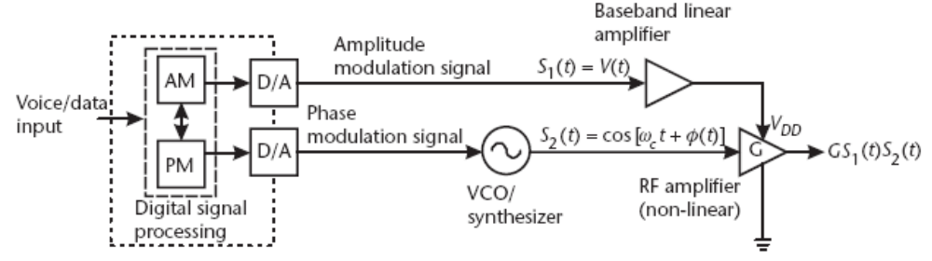
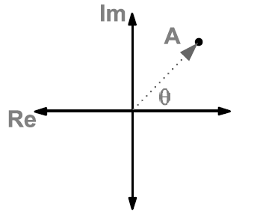
TRANSMITTER ARCHITECTURE(4)
Polar transmitter
No up-conversion, RF signal operated by synthesizer and PA amplitude
Theoretically open to whatever modulation
Theoretically no filtering is needed
Symbol mapping is nonlinear function narrowband application

Slide 40
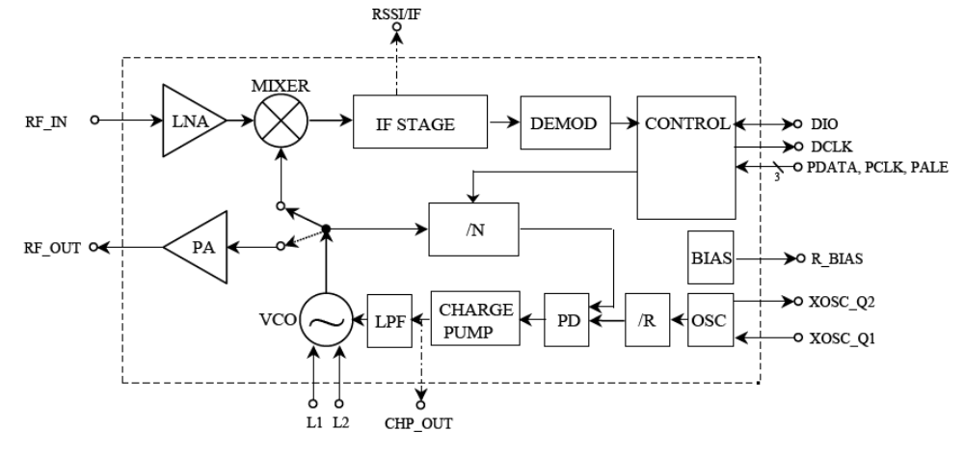
TRANSCEIVER EXAMPLE (I)

Slide 41
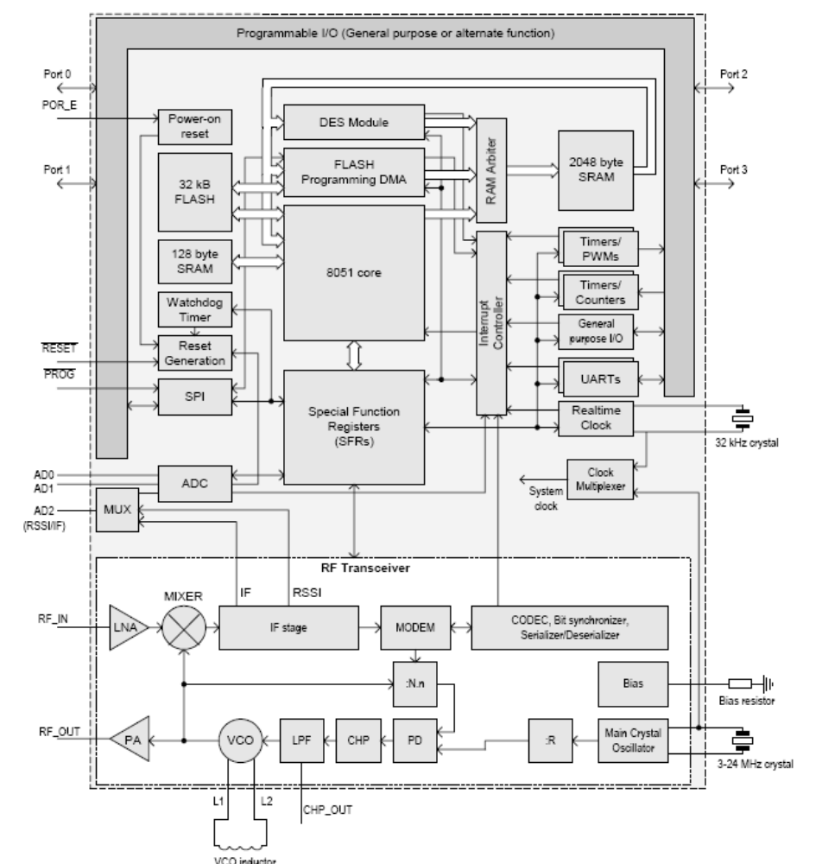
TRANSCEIVER EXAMPLE (II)

Slide 42
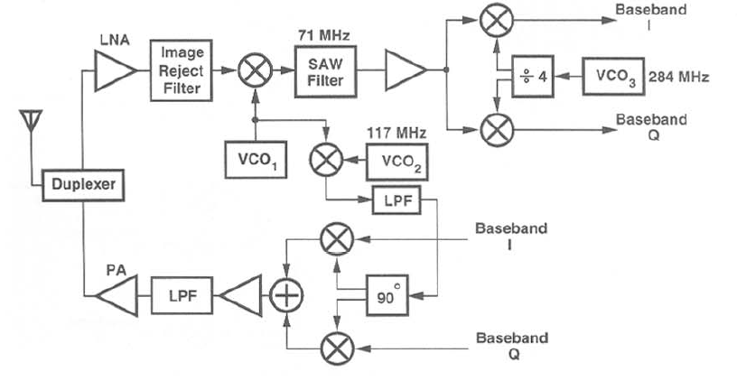
TRANSCEIVER EXAMPLE (III)
Receiver path
Transmitter path

Slide 43
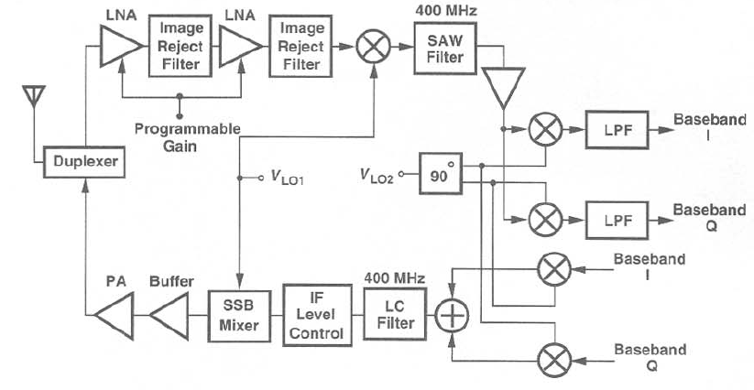
TRANSCEIVER EXAMPLE (VI)
Receiver path
Transmitter path

Slide 44
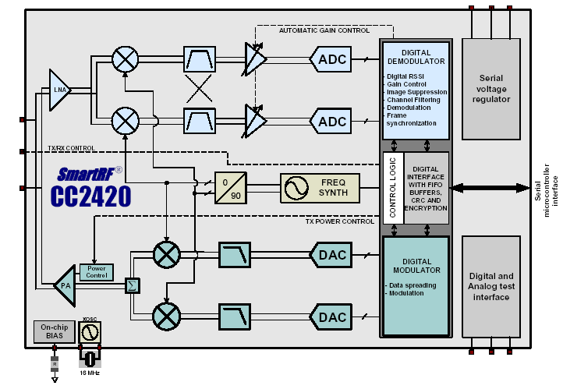
TRANSCEIVER EXAMPLE (V)

